Slide 1
Extended and Unscented Kalman Filter

Slide 2
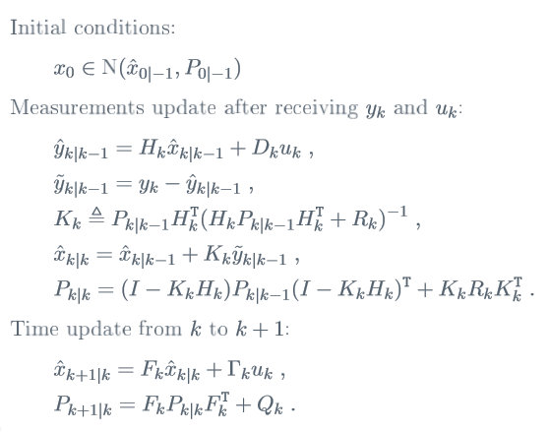
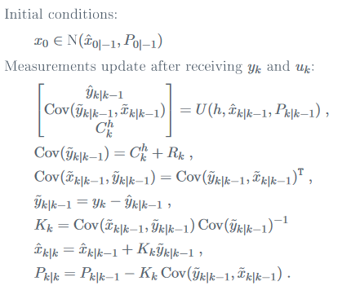
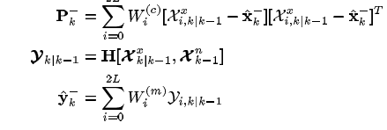
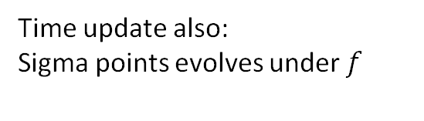
Linear Kalman Filter/EKF
UKF
Y and x estimates must be found using UT
Time update also:
Sigma points evolves under $f$

Slide 3
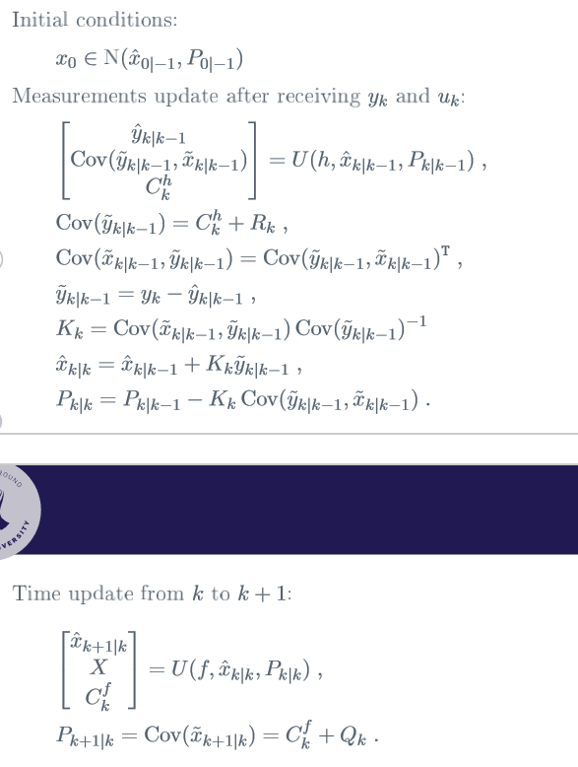
Linear Kalman Filter/EKF EKF UKF
y and x are nonlinear
H and F must be linearised
Y and x estimates must be found using Uncented Transform.

Slide 4
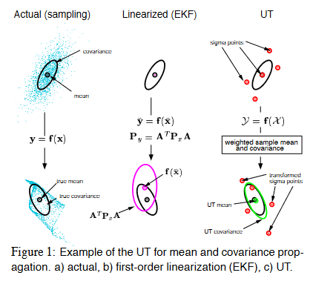
Requires gaussian system
No gurantees of convergence for EKF

Slide 5
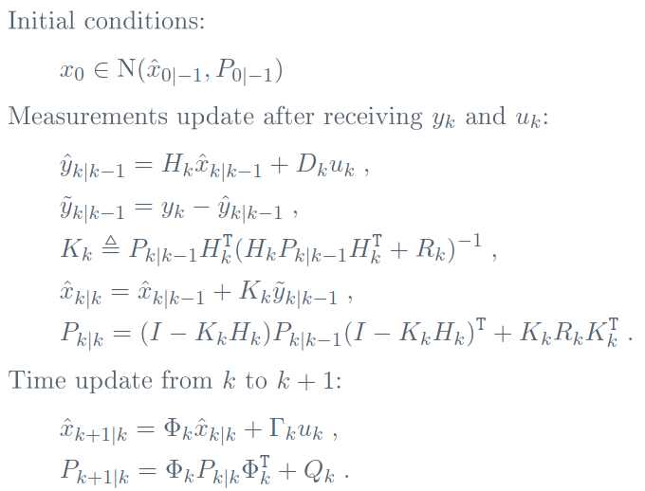
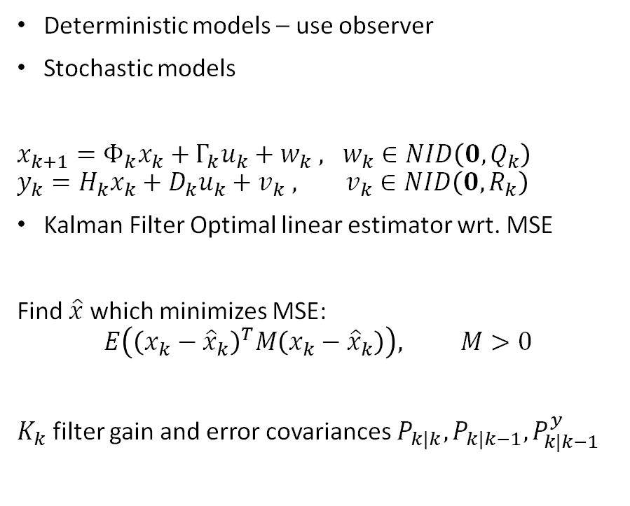
Introduction to Linear Kalman Filter
Deterministic models – use observer
Stochastic models
$x_{k+1}=Φ_{k}x_{k}+Γ_{k}u_{k}+w_{k}$ $, w_{k}∈NID\left(0,Q_{k}\right)$ $y_{k}=H_{k}x_{k}+D_{k}u_{k}+v_{k}$ $, v_{k}∈NID\left(0,R_{k}\right)$
Kalman Filter Optimal linear estimator wrt. MSE
Find $\hat{x}$ which minimizes MSE:
$$E\left({\left(x_{k}−{\hat{x}}_{k}\right)}^{T}M\left(x_{k}−{\hat{x}}_{k}\right)\right), M>0$$
$K_{k}$ filter gain and error covariances $P_{k|k}, P_{k|k−1},P_{k|k−1}^{y}$

Slide 6
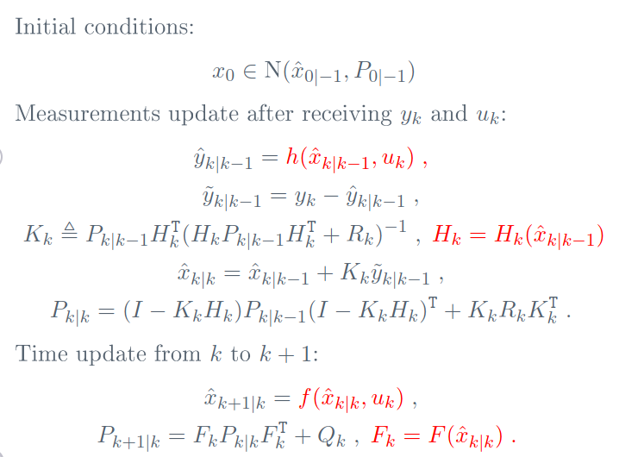
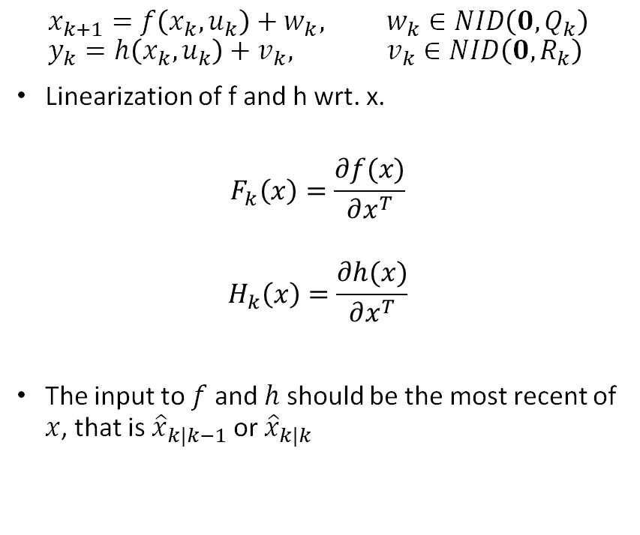
Extended Kalman Filter
$$x_{k+1}=f\left(x_{k},u_{k}\right)+w_{k}, w_{k}∈NID\left(0,Q_{k}\right) \\ y_{k}=h\left(x_{k},u_{k}\right)+v_{k}, v_{k}∈NID\left(0,R_{k}\right)$$
Linearization of f and h wrt. x.
$$F_{k}\left(x\right)=\frac{∂f(x)}{∂x^{T}}$$
$$H_{k}\left(x\right)=\frac{∂h(x)}{∂x^{T}}$$
The input to $f$ and $h$ should be the most recent of $x$, that is ${\hat{x}}_{k|k−1}$ or ${\hat{x}}_{k|k}$

Slide 7

Unscented Transform/Uhlmann filter
Method for calculating statistics of a random variable that undergoes non-linear transform: $y=h\left(x\right)$
Kalman filter as e know
Form a matrix $x$ consisting of $2L+1$ sigma vectors, with weights as follows:
mean and covariance of a non-linear process

Slide 9
Linear Kalman Filter/EKF
UKF
Y and x estimates must be found using UT

